Slide 1
COUSINS
OF
COMPILER

Slide 2
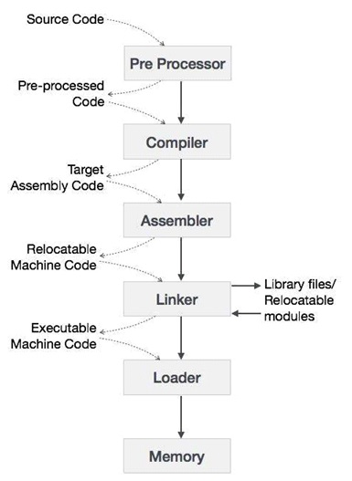
COUSINS OF COMPILER
The input to a compiler may be processed by one or more preprocessors, and further processing of the compiler’s output may be needed before running machine code is obtained.
Cousins of Compiler are
Preprocessor
Assembler
Loader and Link-editor

Slide 3
Preprocessor
A preprocessor is a program that processes its input data (Source Program with Preprocessing Statements) to produce output (Source Program without Preprocessing Statements) that is used as input to another program (Compilers).
They may perform the following functions :
1. Macro processing
2. File Inclusion
3. Rational Preprocessors
4. Language extension

Slide 4
1. Macro processing:
A Preprocessor may allow a user to define macros are shorthands for longer constructs.
2. File Inclusion:
Preprocessor includes header files into the program text. When the preprocessor finds an #include directive it replaces it by the entire content of the specified file.
3. Rational Preprocessors:
These processors change older languages with more modern flow-of-control and data- structuring facilities.
4. Language extension :
These processors attempt to add capabilities to the language by what amounts to built-in macros. For example, the language Equel is a database query language embedded in C.

Slide 5
Assembler
Assembler creates object code by translating assembly instruction mnemonics into machine code.
There are two types of assemblers:
One-pass assemblers go through the source code once and assume that all symbols will be defined before any instruction that references them.
Two-pass assemblers create a table with all symbols and their values in the first pass, and then use the table in a second pass to generate code

Slide 6
Linker and Loader
A linker or link editor is a program that takes one or more objects generated by a compiler and combines them into a single executable program.
Three tasks of the linker are
1. Searches the program to find library routines used by program, e.g. printf(), math
routines.
2. Determines the memory locations that code from each module will occupy and
relocates its instructions by adjusting absolute references
3. Resolves references among files.
A loader is the part of an operating system that is responsible for loading executable programs into permanent memory for execution.

